Slide 1
F
I
R
S
T
C
O
R
N
A
N
I
T
H
I
S
11.17-34
A free CD of this message will be available following the service
It will also be available for podcast later this week at calvaryokc.com

Slide 2
Divisions (v. 18) - schizmata – schisms
Factions - haireseis – heresies
O
A
N
S
11.17-34
I
I
F
I
R
S
T
C
R
N
T
H

Slide 3
Winston Churchill - “When there is no enemy within, the enemies outside cannot hurt you.”
O
A
N
S
11.17-34
I
I
F
I
R
S
T
C
R
N
T
H

Slide 4
John 19:33 - For these things were done that the Scripture should be fulfilled, “Not one of His bones shall be broken.”
O
A
N
S
11.17-34
I
I
F
I
R
S
T
C
R
N
T
H

Slide 5
Ps. 22:14 - I am poured out like water, all my bones are out of joint;
Given thanks - eucharisteō – Eucharist
O
A
N
S
11.17-34
I
I
F
I
R
S
T
C
R
N
T
H

Slide 6
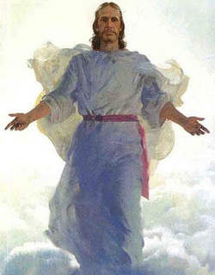
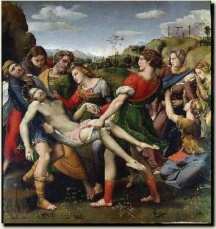
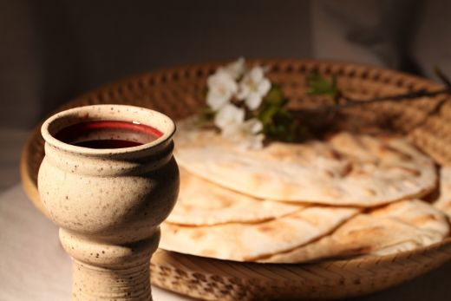
O
A
N
S
11.17-34
I
I
F
I
R
S
T
C
R
N
T
H

Slide 7
Proclaim - katangellō – used of the disciples “preaching” Jesus
O
A
N
S
11.17-34
I
I
F
I
R
S
T
C
R
N
T
H

